Slide 1
STUDENT DETAILS
REGISTRATION NO: COM/B/01-00162/2021
STUDENT NAME: MICHAEL OTIENO KASUKU

Slide 2
PROJECT TITLE
Bursary Mashinani: The Proposed Bursary Application Portal for Kisumu West Constituency

Slide 3
ABSTRACT
This document covers:
1. DEVELOPMENT ENVIRONMENT
2. PROPOSED IDEA
3. SYSTEM ARCHITECTURE
4. SYSTEM REQUIREMENTS
5. SYSTEM MODELING
6. USER INTERFACE DESIGN
7. DESIGN AND ANALYSIS OF ALGORITHMS
8. DEPLOYMENT

Slide 4
1.DEVELOPMENT ENVIRONMENT
1.1 IDE: VS Codium
1.2 Programming language: Python
1.3 Web Framework: Django
1.4 CASE Tools: StarUML and Pencil Project
1.5 DBMS: PostgreSQL
1.6 Version Control: Git and Github
1.7 Deployment: PythonAnywhere

Slide 5
1.1 VS CODIUM
VS Codium is essentially a branded version of Microsoft's Visual Studio Code (VS Code) that is provided without the telemetry tracking and licensing restrictions that are present in the official Visual Studio Code builds.

Slide 6
1.2 PYTHON
Python is a high-level, interpreted programming language known for its simplicity and readability. It was created by Guido van Rossum and first released in 1991.

Slide 7
1.3 DJANGO
Django is a high-level Python web framework that encourages rapid development and clean, pragmatic design.

Slide 8
1.3.1 KEY FEATURES OF DJANGO
Object-Relational Mapping (ORM)
URL routing
Template engine
Security features

Slide 9
1.3.2 WELL KNOWN APPS THAT USES DJANGO
Instagram
Bitbucket
Pinterest

Slide 10
1.4.1 Pencil Project
Pencil Project is an open-source GUI prototyping tool that allows designers and developers to create mockups, wireframes, and prototypes for desktop, mobile, and web applications.

Slide 11
1.4.2 StarUML
StarUML is a sophisticated software modeling tool that supports various modeling languages such as Unified Modeling Language (UML) and Entity-Relationship Diagrams (ERD).

Slide 12
1.5 PostgreSQL
PostgreSQL is an object-relational database management system (ORDBMS) based on POSTGRES,Version 4.2 , developed at the University of California at Berkeley Computer Science Department.

Slide 13
1.5.1 Advantages of PostgreSQL
Reliability and Stability
Performance
Scalability

Slide 14
1.5.2 Popular Apps Using PostgreSQL
Instagram
Netflix
Uber
Spotify

Slide 15
1.6.1 Git
Git is a distributed version control system (DVCS) used for tracking changes in source code during software development. It was created by Linus Torvalds in 2005 to manage the development of the Linux kernel, and it has since become one of the most widely used version control systems in the world.

Slide 16
1.6.1.1 Key features of Git
Version Control
Distributed
Branching and merging
Remote repositories
Staging area
Open source

Slide 17
1.6.2 Github
GitHub is a web-based platform built on top of Git, providing additional features and functionalities for hosting Git repositories and facilitating collaboration among developers. It is one of the most popular platforms for hosting Git repositories and managing software development projects.

Slide 18
1.6.2.1 Key features of Github
Repository hosting
Collaboration tools
Forks and branches
Github pages

Slide 19
1.7 PythonAnywhere
PythonAnywhere is a cloud-based Python development and hosting platform that allows users to write, run, and host Python applications in the cloud without needing to set up servers or infrastructure themselves.

Slide 20
2. THE PROPOSED IDEA
  2.1 Bursary Application Portal
  2.2 Popular bursary application portals in Kenya
  2.3 Why use Django to build bursary application portal
  2.4 Bursary Mashinani

Slide 21
2.1 Bursary Application Portal
A bursary application portal is an online platform designed to facilitate the process of applying for bursaries or scholarships.

Slide 22
2.2 Popular Bursary Application Portals in Kenya
The Higher Education Loans Board (HELB) Portal
KCB Foundation Scholarships Portal
The Equity Group Foundation Scholarships Portal

Slide 23
2.3 Why use Django to build Bursary Application Portal
Rapid Development
Scalability
Security

Slide 24
2.4 Bursary Mashinani
"Bursary Mashinani" is an innovative Bursary Application Portal designed to streamline the bursary application process for Kisumu West Constituency. This digital solution offers:
Efficient Application Process
Secure and User-Friendly Interface
Track Progress Functionality

Slide 25
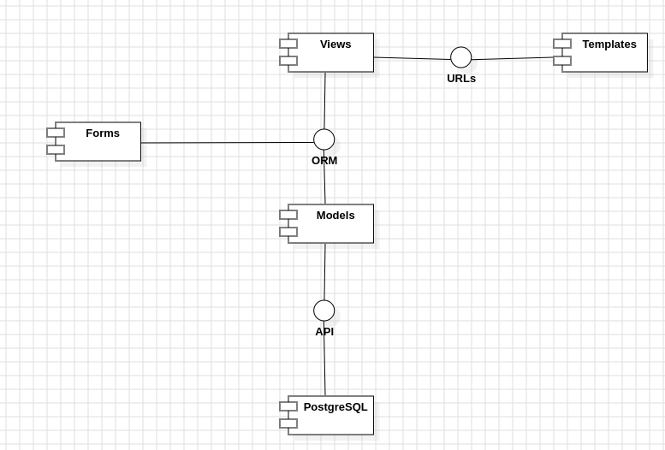
3. SYSTEM ARCHITECTURE

Slide 26
4. SYSTEM REQUIREMENTS
  4.1 Functional Requirements
  4.2 Non Functional Requirements

Slide 27
4.1 Functional Requirements
REQ-1: The portal shall allow the applicant to create a new user account.
REQ-2: The portal shall allow the applicant to login to the respective user account.
REQ -3: The portal shall ensure that the applicant can only apply for bursary once in every financial year.
REQ-4: The portal shall ensure that the national id number provided by the applicant belongs to that particular applicant based on the applicant’s registration number.

Slide 28
4.1 Functional Requirements
REQ-5: The portal shall ensure that the registration number provided by the applicant is actually a valid registration number based on the provided student register of the chosen institution.
REQ-6: The portal shall ensure that the applicant is indeed a resident of the chosen ward.
REQ-7: The portal shall ensure that the provided account number is indeed a valid account number of the chosen institution.
REQ-8: The portal shall ensure that the bursary application can be submitted only if the financial year status is open.
REQ-9: The portal shall ensure that the provided serial number is a valid serial number for the bursary application report to be generated.

Slide 29
4.1 Functional Requirements
REQ-10: The portal shall allow the admin to manage bank data.
REQ-11: The portal shall allow the admin to manage institution data.
REQ-12: The portal shall allow the admin to manage account data.
REQ -13: The portal shall allow the admin to manage country data.
REQ-14: The portal shall allow the admin to manage region data.
REQ-17: The portal shall allow the admin to manage county data.
REQ-18: The portal shall allow the admin to manage constituency data.
REQ-19: The portal shall allow the admin to manage ward data.

Slide 30
4.1 Functional Requirements
REQ-18: The portal shall allow the admin to manage resident data.
REQ-19: The portal shall allow the admin to manage student data.
REQ-20: The portal shall allow the admin to manage financial year data.
REQ-21: The portal shall allow the admin to manage bursary application data.
REQ-22: The portal shall allow the admin to manage user data.
REQ-23: The portal shall allow the admin to manage password reset token data.

Slide 31
4.2 Non Functional Requirements
4.2.1 Performance
4.2.1.1 Optimize database queries by ensuring that only necessary fields are retrieved from the database.
4.2.1.2 Optimize template rendering by minimizing the use of template tags and expressions, and by avoiding heavy computations or complex logic in templates.
4.2.1.3 Optimize URL patterns to avoid unnecessary redirects and route requests efficiently to the appropriate views, minimizing the number of requests and response times.

Slide 32
4.2 Non Functional Requirements
4.2.2 Scalability
4.2.2.1 Design scalable database schema that can accommodate increased data volume without performance degradation.
4.2.2.2 Design views to be stateless and independent of each other to facilitate horizontal scaling.
4.2.2.3 Use scalable URL patterns that are easy to manage and maintain, avoiding patterns that could lead to bottlenecks or resource contention as the application grows.

Slide 33
4.2 Non Functional Requirements
4.2.3 Reliability
4.2.3.1 Ensure data integrity by enforcing database constraints such as unique constraints, foreign key constraints, and NOT NULL constraints.
4.2.3.2 Implement error handling and logging in views to capture and handle exceptions gracefully, preventing application crashes and downtime.
4.2.3.3 Implement form validation to ensure that only valid data is submitted to the server, reducing the likelihood of data corruption or application errors.

Slide 34
4.2 Non Functional Requirements
4.2.4 Security
4.2.4.1 Protect sensitive data by encrypting it before storing it in the database.
4.2.4.2 Implement measures to prevent Cross-Site Request Forgery (CSRF) attacks, ensuring the security and integrity of user interactions with the application.
4.2.4.3 Use HTTPS to encrypt data transmitted between the client and server, preventing eavesdropping and tampering with sensitive information. Configure Django to enforce HTTPS by setting the SECURE_SSL_REDIRECT setting to True.

Slide 35
4.2 Non Functional Requirements
4.2.5 Usability
4.2.5.1 Design intuitive and user-friendly data models that accurately represent the real-world entities and relationships in the application domain. Use meaningful field names and relationships to make it easier for developers and users to understand the data model.
4.2.5.2 Design views to provide clear and informative feedback to users, guiding them through the application process and helping them understand their actions. Use descriptive error messages and success messages to provide feedback to users.
4.2.5.3 Design forms with clear labels, instructions, and error messages to help users complete them accurately and efficiently. Use Django's form widgets and labels to customize the appearance and behavior of form fields.

Slide 36
5. SYSTEM MODELING
  5.1 Use Case Diagram
  5.2 Context Diagram
  5.3 Level 1 Data Flow Diagram
  5.4 Entity Relationship Diagram

Slide 37
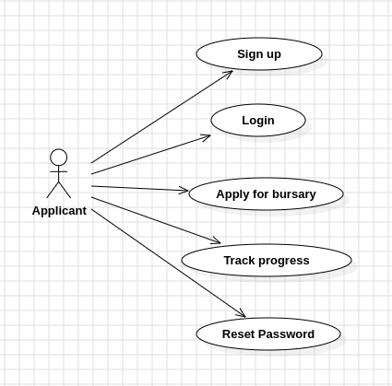
5.1.1 Use Case: Applicant

Slide 38
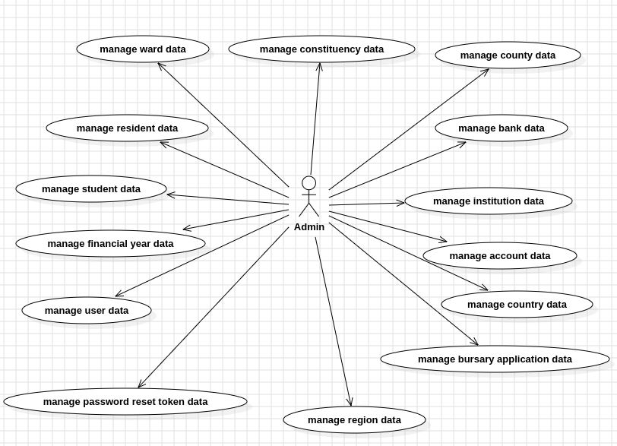
5.1.2 Use Case: Admin

Slide 39
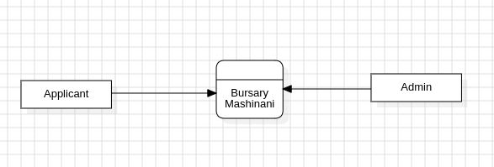
5.2 Context Diagram

Slide 40
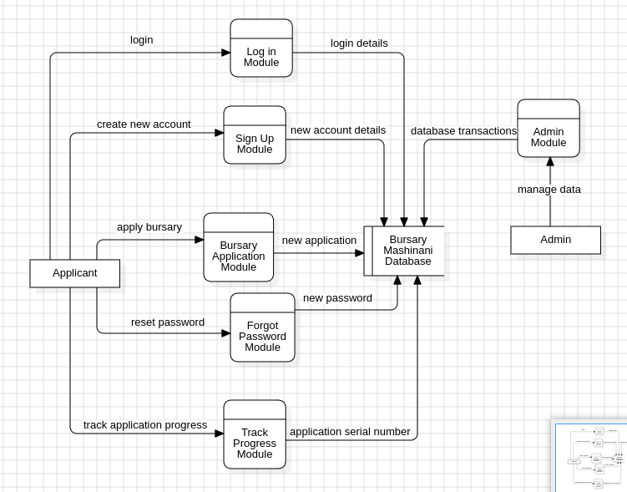
5.3 Level 1 DFD

Slide 41
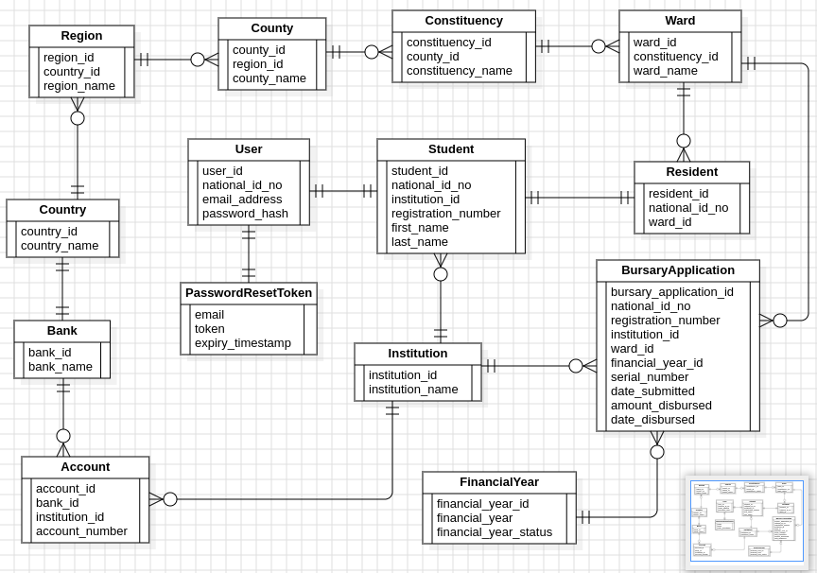
5.4 ER Diagram

Slide 42
6. USER INTERFACE DESIGN
  6.1 Login Page
  6.2 Sign Up Page
  6.3 Forgot Password Page
  6.4 Landing Page
  6.5 Application Page
  6.6 Track Progress Page
  6.7 Application Report Page
  6.8 Success Page
  6.9 Error Page

Slide 43
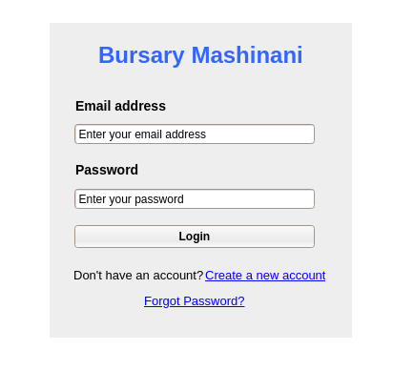
6.1 Login Page

Slide 44
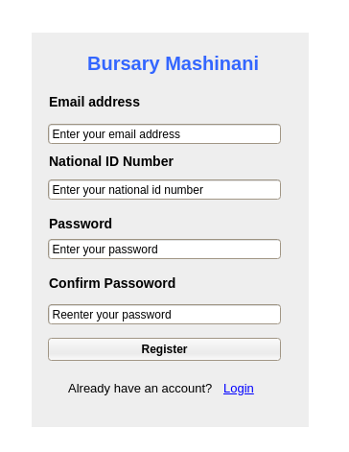
6.2 Sign Up Page

Slide 45
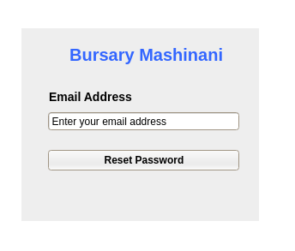
6.3 Forgot Password Page

Slide 46
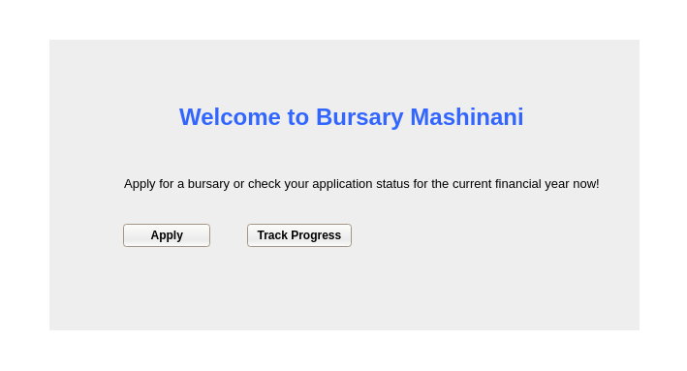
6.4 Landing Page

Slide 47
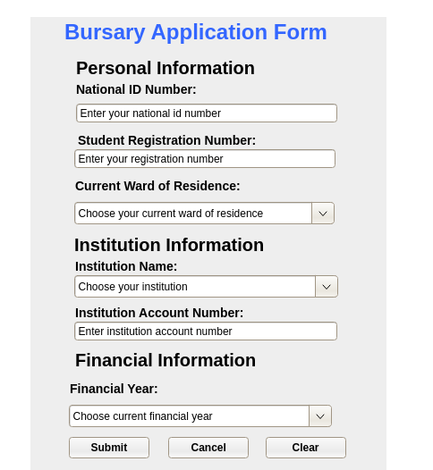
6.5 Application Page

Slide 48
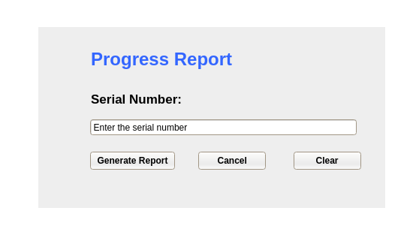
6.6 Track Progress Page

Slide 49
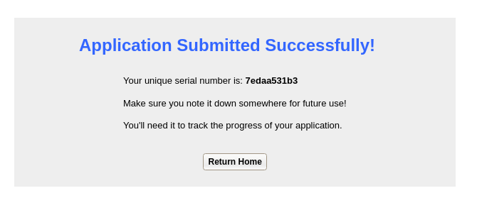
6.7 Success Page

Slide 50
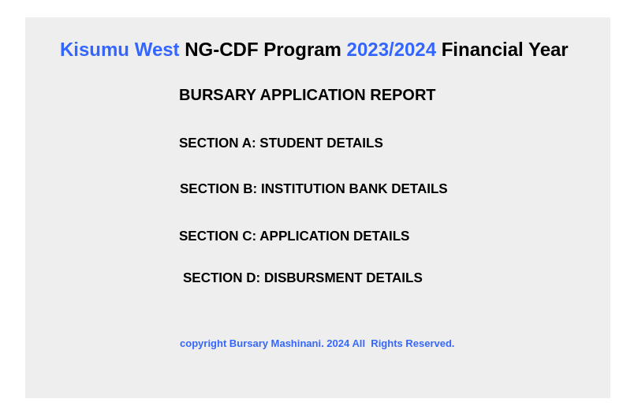
6.8 Application Report Page

Slide 51
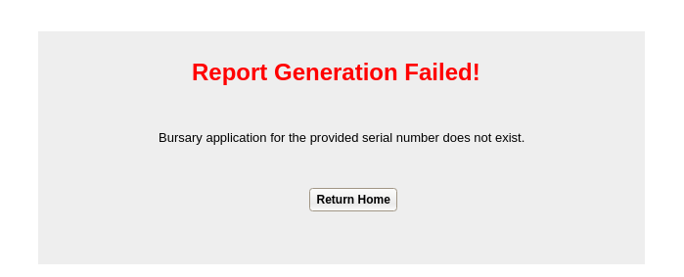
6.9 Error Page

Slide 52
7. DESIGN AND ANALYSIS OF ALGORITHMS
  7.1 Models
  7.2 Migrations
  7.3 Forms
  7.4 Views
  7.5 CSS Styles
  7.6 Scripts
  7.7 URLs
  7.8 Templates

Slide 53
Note: Psuedocode
Pseudocode is a way to represent algorithms in a high-level, informal manner using plain language. It is not tied to any specific programming language syntax, which makes it useful for planning and discussing algorithms before implementation. Pseudocode often resembles the structure of the code in a high-level programming language, but it focuses more on describing the logic and steps of the algorithm in a human-readable format.

Slide 54
7.1 Models
7.1.1 Bank
7.12 Institution
7.1.3 Account
7.1.4 Country
7.1.5 Region
7.1.6 County
7.1.7 Constituency
7.1.8 Ward
7.1.9 Resident
7.1.10 Student
7.1.11 Financial Year
7.1.12 Bursary Application
7.1.13 User
7.1.14 Password Reset Token

Slide 55
7.1.1 Bank
class Bank:
// Attributes
bank_id : Integer
bank_name : String
// Constructor
Bank(bank_id, bank_name):
set this.bank_id to bank_id
set this.bank_name to bank_name
// Method to return bank_name
method __str__() returns String:
return this.bank_name

Slide 56
7.1.2 Institution
class Institution:
// Attributes
institution_id : Integer
institution_name : String
// Constructor
Institution(institution_id, institution_name):
set this.institution_id to institution_id
set this.institution_name to institution_name
// Method to return institution_name
method __str__() returns String:
return this.institution_name

Slide 57
7.1.3 Account
class Account:
// Attributes
account_id : Integer
institution_id : Integer // Foreign key to Institution
bank_id : Integer // Foreign key to Bank
account_number : String
// Constructor
Account(account_id, institution_id, bank_id, account_number):
set this.account_id to account_id
set this.institution_id to institution_id
set this.bank_id to bank_id
set this.account_number to account_number
// Method to return account_number
method __str__() returns String:
return this.account_number

Slide 58
7.1.4 Country
class Country:
// Attributes
country_id : Integer
country_name : String
// Constructor
Country(country_id, country_name):
set this.country_id to country_id
set this.country_name to country_name
// Method to return country_name
method __str__() returns String:
return this.country_name

Slide 59
7.1.5 Region
class Region:
// Attributes
region_id : Integer
country_id : Integer // Foreign key to Country
region_name : String
// Constructor
Region(region_id, country_id, region_name):
set this.region_id to region_id
set this.country_id to country_id
set this.region_name to region_name
// Method to return region_name
method __str__() returns String:
return this.region_name

Slide 60
7.1.6 County
class County:
// Attributes
county_id : Integer
region_id : Integer // Foreign key to Region
county_name : String
// Constructor
County(county_id, region_id, county_name):
set this.county_id to county_id
set this.region_id to region_id
set this.county_name to county_name
// Method to return county_name
method __str__() returns String:
return this.county_name

Slide 61
7.1.7 Constituency
class Constituency:
// Attributes
constituency_id : Integer
county_id : Integer // Foreign key to County
constituency_name : String
// Constructor
Constituency(constituency_id, county_id, constituency_name):
set this.constituency_id to constituency_id
set this.county_id to county_id
set this.constituency_name to constituency_name
// Method to return constituency_name
method __str__() returns String:
return this.constituency_name

Slide 62
7.1.8 Ward
class Ward:
// Attributes
ward_id : Integer
constituency_id : Integer // Foreign key to Constituency
ward_name : String
// Constructor
Ward(ward_id, constituency_id, ward_name):
set this.ward_id to ward_id
set this.constituency_id to constituency_id
set this.ward_name to ward_name
// Method to return ward_name
method __str__() returns String:
return this.ward_name

Slide 63
7.1.9 Resident
class Resident:
// Attributes
resident_id : Integer
national_id_no : String
ward_id : Integer // Foreign key to Ward
// Constructor
Resident(resident_id, national_id_no, ward_id):
set this.resident_id to resident_id
set this.national_id_no to national_id_no
set this.ward_id to ward_id
// Method to return national_id_no
method __str__() returns String:
return this.national_id_no

Slide 64
7.1.10 Student
class Student:
// Attributes
student_id : Integer
national_id_no : String
institution_id : Integer // Foreign key to Institution
registration_number : String
first_name : String
last_name : String
// Constructor
Student(student_id, national_id_no, institution_id, registration_number, first_name, last_name):
set this.student_id to student_id
set this.national_id_no to national_id_no
set this.institution_id to institution_id
set this.registration_number to registration_number
set this.first_name to first_name
set this.last_name to last_name
// Method to return registration_number
method __str__() returns String:
return this.registration_number

Slide 65
7.1.11 Financial Year
class FinancialYear:
// Attributes
financial_year_id : Integer
financial_year : String
financial_year_status : String
// Constructor
FinancialYear(financial_year_id, financial_year, financial_year_status):
set this.financial_year_id to financial_year_id
set this.financial_year to financial_year
set this.financial_year_status to financial_year_status
// Method to return financial_year
method __str__() returns String:
return this.financial_year
// Validation function for financial year
function validate_financial_year(value) returns Void:
parts = split value by '/'
if length of parts is not 2:
raise ValidationError('Invalid financial year!')
AAAA, BBBB = parts[0], parts[1]
if not (AAAA is a digit and BBBB is a digit):
raise ValidationError('Invalid financial year!')
AAAA, BBBB = convert AAAA to integer, convert BBBB to integer
if not (1900 <= AAAA <= 2100 and 1900 <= BBBB <= 2100 and AAAA is equal to BBBB - 1):
raise ValidationError('Invalid financial year!')
// Validation function for financial year status
function validate_financial_year_status(value) returns Void:
if value not in ['Open', 'Closed']:
raise ValidationError('Financial year status should be either "Open" or "Closed"!')

Slide 66
7.1.12 Bursary Application
class BursaryApplication:
// Attributes
bursary_application_id : Integer
national_id_no : String
registration_number : String
institution_id : Integer // Foreign key to Institution
account_number : String
ward_id : Integer // Foreign key to Ward
financial_year_id : Integer // Foreign key to FinancialYear
serial_number : String
date_submitted : DateTime
amount_disbursed : Decimal
date_disbursed : DateTime
// Constructor
BursaryApplication(bursary_application_id, national_id_no, registration_number, institution_id, account_number, ward_id, financial_year_id, serial_number, date_submitted, amount_disbursed, date_disbursed):
set this.bursary_application_id to bursary_application_id
set this.national_id_no to national_id_no
set this.registration_number to registration_number
set this.institution_id to institution_id
set this.account_number to account_number
set this.ward_id to ward_id
set this.financial_year_id to financial_year_id
set this.serial_number to serial_number
set this.date_submitted to date_submitted
set this.amount_disbursed to amount_disbursed
set this.date_disbursed to date_disbursed
// Validation function for serial number
function validate_serial_number(value) returns Void:
if not matches value against regex pattern r'^[a-zA-Z0-9]{10}$':
raise ValidationError('Serial number must be exactly 10 alphanumeric characters!')
// Clean method
method clean() returns Void:
super().clean()
if this.date_disbursed and this.date_disbursed < this.date_submitted:
raise ValidationError("Date disbursed should be greater than or equal to the date submitted!")
// Method to return serial_number
method __str__() returns String:
return this.serial_number

Slide 67
7.1.13 User
class User:
// Attributes
user_id : Integer
national_id_no : String
email_address : String
password_hash : String
// Constructor
User(user_id, national_id_no, email_address, password_hash):
set this.user_id to user_id
set this.national_id_no to national_id_no
set this.email_address to email_address
set this.password_hash to password_hash
// Method to set password
method set_password(raw_password) returns Void:
this.password_hash = make_password(raw_password)
// Method to check password
method check_password(raw_password) returns Boolean:
return check_password(raw_password, this.password_hash)
// Custom validation for password field
method clean() returns Void:
if length of this.password_hash < 8:
raise ValidationError("Password must be at least 8 characters long!")
// Method to return email_address
method __str__() returns String:
return this.email_address

Slide 68
7.1.14 Password Reset Token
class PasswordResetToken:
// Attributes
email : String
token : String
expiry_timestamp : DateTime
// Constructor
PasswordResetToken(email, token, expiry_timestamp):
set this.email to email
set this.token to token
set this.expiry_timestamp to expiry_timestamp
// Method to return email
method get_email() returns String:
return this.email
// Method to return token
method get_token() returns String:
return this.token
// Method to return expiry_timestamp
method get_expiry_timestamp() returns DateTime:
return this.expiry_timestamp

Slide 69
7.2 Migrations
7.2.1 insert banks
7.2.2 insert institutions
7.2.3 insert account
7.2.4 insert countries
7.2.5 insert regions
7.2.6 insert counties
7.2.7 insert constituency
7.2.8 insert ward
7.2.9 insert residents
7.2.10 insert financial year
7.2.11 insert students

Slide 70
7.2.1 Insert banks
# Import necessary modules
import openpyxl
# Define a function to insert Kenyan banks into the database
function insert_kenyan_banks(apps, schema_editor):
# Get the Bank model from the 'mashinani' app
Bank = apps.get_model('mashinani', 'Bank')
try:
# Attempt to load data from an Excel workbook
try:
workbook = openpyxl.load_workbook('mashinani/data/data.xlsx')
sheet = workbook['Bank']
# Extract bank names from the Excel sheet
banks_data = []
for row in sheet.iter_rows(min_row=2, values_only=True): # Assuming data starts from second row
bank_name = row[0] # Assuming bank name is in the first column
banks_data.append({'bank_name': bank_name})
# Insert data into the model
for data in banks_data:
try:
Bank.objects.create(**data)
except ValidationError as e:
print("Validation Error:", e)
# Handle the case where the file is not found
except FileNotFoundError:
print("File not found. Please check the path to the Excel file.")
# Handle any other exceptions
except Exception as e:
print("An error occurred:", e)
# Handle any exceptions
except Exception as e:
print("An error occurred:", e)
# Define a migration class
class Migration(migrations.Migration):
# Define dependencies
dependencies = [
('mashinani', '0001_initial'),
]
# Define operations
operations = [
migrations.RunPython(insert_kenyan_banks)
]

Slide 71
7.2.2 Insert institutions
# Import necessary modules
import openpyxl
# Define a function to insert Kenyan institutions into the database
function insert_kenyan_institutions(apps, schema_editor):
# Get the Institution model from the 'mashinani' app
Institution = apps.get_model('mashinani', 'Institution')
try:
# Attempt to load data from an Excel workbook
try:
workbook = openpyxl.load_workbook('mashinani/data/data.xlsx')
sheet = workbook['Institution']
# Extract institution names from the Excel sheet
institutions_data = []
for row in sheet.iter_rows(min_row=2, values_only=True): # Assuming data starts from second row
institution_name = row[0] # Assuming institution name is in the first column
institutions_data.append({'institution_name': institution_name})
# Insert data into the model
for data in institutions_data:
try:
Institution.objects.create(**data)
except ValidationError as e:
print("Validation Error:", e)
# Handle the case where the file is not found
except FileNotFoundError:
print("File not found. Please check the path to the Excel file.")
# Handle any other exceptions
except Exception as e:
print("An error occurred:", e)
# Handle any exceptions
except Exception as e:
print("An error occurred:", e)
# Define a migration class
class Migration(migrations.Migration):
# Define dependencies
dependencies = [
('mashinani', '0002_auto_20240403_1335'),
]
# Define operations
operations = [
migrations.RunPython(insert_kenyan_institutions)
]

Slide 72
7.2.3 Insert account
# Import necessary modules
import openpyxl
# Define a function to insert account data into the database
function insert_account_data(apps, schema_editor):
# Get models from the 'mashinani' app
Account = apps.get_model('mashinani', 'Account')
Institution = apps.get_model('mashinani', 'Institution')
Bank = apps.get_model('mashinani', 'Bank')
try:
# Attempt to load data from an Excel workbook
try:
workbook = openpyxl.load_workbook('mashinani/data/data.xlsx')
sheet = workbook['Account']
# Iterate over rows in the Excel sheet and extract account information
accounts_data = []
for row in sheet.iter_rows(min_row=2, values_only=True): # Assuming data starts from second row
institution_name = row[0] # Assuming institution name is in the first column
bank_name = row[1] # Assuming bank name is in the second column
account_number = row[2] # Assuming account number is in the third column
# Fetch institution and bank objects from the database
try:
institution = Institution.objects.get(institution_name=institution_name)
bank = Bank.objects.get(bank_name=bank_name)
except ObjectDoesNotExist as e:
print("Error:", e)
continue # Skip this row if institution or bank doesn't exist
# Create dictionary for account data
account_data = {
'institution_id': institution,
'bank_id': bank,
'account_number': account_number
}
# Append account data to list
accounts_data.append(account_data)
# Insert data into the model
for data in accounts_data:
Account.objects.create(**data)
# Handle the case where the file is not found
except FileNotFoundError:
print("File not found. Please check the path to the Excel file.")
# Handle any other exceptions
except Exception as e:
print("An error occurred:", e)
# Handle any exceptions
except Exception as e:
print("An error occurred:", e)
# Define a migration class
class Migration(migrations.Migration):
# Define dependencies
dependencies = [
('mashinani', '0003_auto_20240403_1338'),
]
# Define operations
operations = [
migrations.RunPython(insert_account_data)
]

Slide 73
7.2.4 Insert countries
# Import necessary modules
import openpyxl
# Define a function to insert countries into the database
function insert_countries(apps, schema_editor):
# Get the Country model from the 'mashinani' app
Country = apps.get_model('mashinani', 'Country')
try:
# Attempt to load data from an Excel workbook
try:
workbook = openpyxl.load_workbook('mashinani/data/data.xlsx')
sheet = workbook['Country']
# Extract country names from the Excel sheet
countries_data = []
for row in sheet.iter_rows(min_row=2, values_only=True): # Assuming data starts from second row
country_name = row[0] # Assuming country name is in the first column
countries_data.append({'country_name': country_name})
# Insert data into the model
for data in countries_data:
try:
Country.objects.create(**data)
except ValidationError as e:
print("Validation Error:", e)
# Handle the case where the file is not found
except FileNotFoundError:
print("File not found. Please check the path to the Excel file.")
# Handle any other exceptions
except Exception as e:
print("An error occurred:", e)
# Handle any exceptions
except Exception as e:
print("An error occurred:", e)
# Define a migration class
class Migration(migrations.Migration):
# Define dependencies
dependencies = [
('mashinani', '0004_auto_20240403_1340'),
]
# Define operations
operations = [
migrations.RunPython(insert_countries)
]

Slide 74
7.2.5 Insert regions
# Import necessary modules
import openpyxl
# Define a function to insert regions into the database
function insert_regions(apps, schema_editor):
# Get models from the 'mashinani' app
Region = apps.get_model('mashinani', 'Region')
Country = apps.get_model('mashinani', 'Country')
try:
# Attempt to load data from an Excel workbook
try:
workbook = openpyxl.load_workbook('mashinani/data/data.xlsx')
sheet = workbook['Region']
# Iterate over rows in the Excel sheet and extract region information
regions_data = []
for row in sheet.iter_rows(min_row=2, values_only=True): # Assuming data starts from second row
country_name = row[0] # Assuming country name is in the first column
region_name = row[1] # Assuming region name is in the second column
# Fetch country objects from the database
try:
country = Country.objects.get(country_name=country_name)
except ObjectDoesNotExist as e:
print("Error:", e)
continue # Skip this row if country doesn't exist
# Create dictionary for region data
region_data = {
'country_id': country,
'region_name': region_name
}
# Append region data to list
regions_data.append(region_data)
# Insert data into the model
for data in regions_data:
Region.objects.create(**data)
# Handle the case where the file is not found
except FileNotFoundError:
print("File not found. Please check the path to the Excel file.")
# Handle any other exceptions
except Exception as e:
print("An error occurred:", e)
# Handle any exceptions
except Exception as e: print("An error occurred:", e)
# Define a migration class
class Migration(migrations.Migration):
# Define dependencies
dependencies = [
('mashinani', '0005_auto_20240403_1435'),
]
# Define operations
operations = [
migrations.RunPython(insert_regions)
]

Slide 75
7.2.6 Insert counties
# Import necessary modules
import openpyxl
# Define a function to insert counties into the database
function insert_counties(apps, schema_editor):
# Get models from the 'mashinani' app
County = apps.get_model('mashinani', 'County')
Region = apps.get_model('mashinani', 'Region')
try:
# Attempt to load data from an Excel workbook
try:
workbook = openpyxl.load_workbook('mashinani/data/data.xlsx')
sheet = workbook['County']
# Iterate over rows in the Excel sheet and extract county information
counties_data = []
for row in sheet.iter_rows(min_row=2, values_only=True): # Assuming data starts from second row
region_name = row[0] # Assuming region name is in the first column
county_name = row[1] # Assuming county name is in the second column
# Fetch region objects from the database
try:
region = Region.objects.get(region_name=region_name)
except ObjectDoesNotExist as e:
print("Error:", e)
continue # Skip this row if region doesn't exist
# Create dictionary for county data
county_data = {
'region_id': region,
'county_name': county_name
}
# Append county data to list
counties_data.append(county_data)
# Insert data into the model
for data in counties_data:
County.objects.create(**data)
# Handle the case where the file is not found
except FileNotFoundError:
print("File not found. Please check the path to the Excel file.")
# Handle any other exceptions
except Exception as e:
print("An error occurred:", e)
# Handle any exceptions
except Exception as e:
print("An error occurred:", e)
# Define a migration class
class Migration(migrations.Migration):
# Define dependencies
dependencies = [
('mashinani', '0006_auto_20240403_1437'),
]
# Define operations
operations = [
migrations.RunPython(insert_counties)
]

Slide 76
7.2.7 Insert constituencies
# Define a function to insert constituencies into the database
function insert_constituencies(apps, schema_editor):
# Get models from the 'mashinani' app
Constituency = apps.get_model('mashinani', 'Constituency')
County = apps.get_model('mashinani', 'County')
try:
# Attempt to load data from an Excel workbook
try:
workbook = openpyxl.load_workbook('mashinani/data/data.xlsx')
sheet = workbook['Constituency']
# Iterate over rows in the Excel sheet and extract constituency information
constituencies_data = []
for row in sheet.iter_rows(min_row=2, values_only=True): # Assuming data starts from second row
county_name = row[0] # Assuming county name is in the first column
constituency_name = row[1] # Assuming constituency name is in the second column
# Fetch county objects from the database
try:
county = County.objects.get(county_name=county_name)
except ObjectDoesNotExist as e:
print("Error:", e)
continue # Skip this row if county doesn't exist
# Create dictionary for constituency data
constituency_data = {
'county_id': county,
'constituency_name': constituency_name
}
# Append constituency data to list
constituencies_data.append(constituency_data)
# Insert data into the model
for data in constituencies_data:
Constituency.objects.create(**data)
# Handle the case where the file is not found
except FileNotFoundError:
print("File not found. Please check the path to the Excel file.")
# Handle any other exceptions
except Exception as e:
print("An error occurred:", e)
# Handle any exceptions
except Exception as e:
print("An error occurred:", e)
# Define a migration class
class Migration(migrations.Migration):
# Define dependencies
dependencies = [
('mashinani', '0007_auto_20240403_1450'),
]
# Define operations
operations = [
migrations.RunPython(insert_constituencies)
]

Slide 77
7.2.8 Insert wards
# Define a function to insert wards into the database
function insert_wards(apps, schema_editor):
# Get models from the 'mashinani' app
Ward = apps.get_model('mashinani', 'Ward')
Constituency = apps.get_model('mashinani', 'Constituency')
try:
# Attempt to load data from an Excel workbook
try:
workbook = openpyxl.load_workbook('mashinani/data/data.xlsx')
sheet = workbook['Ward']
# Iterate over rows in the Excel sheet and extract ward information
wards_data = []
for row in sheet.iter_rows(min_row=2, values_only=True): # Assuming data starts from second row
constituency_name = row[0] # Assuming constituency name is in the first column
ward_name = row[1] # Assuming ward name is in the second column
# Fetch constituency objects from the database
try:
constituency = Constituency.objects.get(constituency_name=constituency_name)
except ObjectDoesNotExist as e:
print("Error:", e)
continue # Skip this row if constituency doesn't exist
# Create dictionary for ward data
ward_data = {
'constituency_id': constituency,
'ward_name': ward_name
}
# Append ward data to list
wards_data.append(ward_data)
# Insert data into the model
for data in wards_data:
Ward.objects.create(**data)
# Handle the case where the file is not found
except FileNotFoundError:
print("File not found. Please check the path to the Excel file.")
# Handle any other exceptions
except Exception as e:
print("An error occurred:", e)
# Handle any exceptions
except Exception as e:
print("An error occurred:", e)
# Define a migration class
class Migration(migrations.Migration):
# Define dependencies
dependencies = [
('mashinani', '0008_auto_20240403_1515'),
]
# Define operations
operations = [
migrations.RunPython(insert_wards)
]

Slide 78
7.2.9 Insert residents
# Define a function to insert residents into the database
function insert_residents(apps, schema_editor):
# Get models from the 'mashinani' app
Resident = apps.get_model('mashinani', 'Resident')
Ward = apps.get_model('mashinani', 'Ward')
try:
# Attempt to load data from an Excel workbook
try:
workbook = openpyxl.load_workbook('mashinani/data/data.xlsx')
sheet = workbook['Resident']
# Iterate over rows in the Excel sheet and extract resident information
residents_data = []
for row in sheet.iter_rows(min_row=2, values_only=True): # Assuming data starts from second row
national_id_no = row[0] # Assuming National ID Number is in the first column
ward_name = row[1] # Assuming ward name is in the second column
# Fetch ward objects from the database
try:
ward = Ward.objects.get(ward_name=ward_name)
except ObjectDoesNotExist as e:
print("Error:", e)
continue # Skip this row if ward doesn't exist
# Create dictionary for resident data
resident_data = {
'national_id_no': national_id_no,
'ward_id': ward
}
# Append resident data to list
residents_data.append(resident_data)
# Insert data into the model
for data in residents_data:
Resident.objects.create(**data)
# Handle the case where the file is not found
except FileNotFoundError:
print("File not found. Please check the path to the Excel file.")
# Handle any other exceptions
except Exception as e:
print("An error occurred:", e)
# Handle any exceptions
except Exception as e:
print("An error occurred:", e)
# Define a migration class
class Migration(migrations.Migration):
# Define dependencies
dependencies = [
('mashinani', '0009_auto_20240403_1519'),
]
# Define operations
operations = [
migrations.RunPython(insert_residents)
]

Slide 79
7.2.10 Insert financial year
# Define a function to insert financial years into the database
function insert_financial_years(apps, schema_editor):
# Get the FinancialYear model from the 'mashinani' app
FinancialYear = apps.get_model('mashinani', 'FinancialYear')
try:
# Attempt to load data from an Excel workbook
try:
workbook = openpyxl.load_workbook('mashinani/data/data.xlsx')
sheet = workbook['FinancialYear']
# Iterate over rows in the Excel sheet and extract financial year information
financial_years_data = []
for row in sheet.iter_rows(min_row=2, values_only=True): # Assuming data starts from second row
financial_year = row[0] # Assuming Financial Year is in the first column
financial_year_status = row[1] # Assuming Financial Year Status is in the second column
# Create dictionary for financial year data
financial_year_data = {
'financial_year': financial_year,
'financial_year_status': financial_year_status
}
# Append financial year data to list
financial_years_data.append(financial_year_data)
# Insert data into the model
for data in financial_years_data:
FinancialYear.objects.create(**data)
# Handle the case where the file is not found
except FileNotFoundError:
print("File not found. Please check the path to the Excel file.")
# Handle any other exceptions
except Exception as e:
print("An error occurred:", e)
# Handle any exceptions
except Exception as e:
print("An error occurred:", e)
# Define a migration class
class Migration(migrations.Migration):
# Define dependencies
dependencies = [
('mashinani', '0010_auto_20240403_1612'),
]
# Define operations
operations = [
migrations.RunPython(insert_financial_years)
]

Slide 80
7.2.11 Insert students
# Define a function to insert students into the database
function insert_students(apps, schema_editor):
# Get models from the 'mashinani' app
Student = apps.get_model('mashinani', 'Student')
Institution = apps.get_model('mashinani', 'Institution')
try:
# Attempt to load data from an Excel workbook
try:
workbook = openpyxl.load_workbook('mashinani/data/data.xlsx')
sheet = workbook['Student']
# Iterate over rows in the Excel sheet and extract student information
students_data = []
for row in sheet.iter_rows(min_row=2, values_only=True): # Assuming data starts from second row
national_id_no = row[0] # Assuming National ID Number is in the first column
institution_name = row[1]
registration_number = row[2]
first_name = row[3]
last_name = row[4]
# Fetch institution objects from the database
try:
institution = Institution.objects.get(institution_name=institution_name)
except ObjectDoesNotExist as e:
print("Error:", e)
continue # Skip this row if institution doesn't exist
# Create dictionary for student data
student_data = {
'national_id_no': national_id_no,
'institution_id': institution,
'registration_number': registration_number,
'first_name': first_name,
'last_name': last_name,
}
# Append student data to list
students_data.append(student_data)
# Insert data into the model
for data in students_data:
Student.objects.create(**data)
# Handle the case where the file is not found
except FileNotFoundError:
print("File not found. Please check the path to the Excel file.")
# Handle any other exceptions
except Exception as e:
print("An error occurred:", e)
# Handle any exceptions
except Exception as e:
print("An error occurred:", e)
# Define a migration class
class Migration(migrations.Migration):
# Define dependencies
dependencies = [
('mashinani', '0011_auto_20240403_1618'),
]
# Define operations
operations = [
migrations.RunPython(insert_students)
]

Slide 81
7.3 Forms
7.3.1 Register Form
7.3.2 Login Form
7.3.3 Password Reset Form
7.3.4 Application Form

Slide 82
7.3.1 Register Form
class LoginForm extends Form:
email_address = EmailField(
label="Email Address",
widget=EmailInput(attrs={'class': 'form-control', 'placeholder': 'Enter your email address'})
)
password = CharField(
label="Password",
widget=PasswordInput(attrs={'class': 'form-control', 'placeholder': 'Enter your password'})
)
def clean():
cleaned_data = super().clean()
email_address = cleaned_data.get("email_address")
password = cleaned_data.get("password")
return cleaned_data

Slide 83
7.3.2 Login Form
class LoginForm extends Form:
email_address = EmailField(
label="Email Address",
widget=EmailInput(attrs={'class': 'form-control', 'placeholder': 'Enter your email address'})
)
password = CharField(
label="Password",
widget=PasswordInput(attrs={'class': 'form-control', 'placeholder': 'Enter your password'})
)
def clean():
cleaned_data = super().clean()
email_address = cleaned_data.get("email_address")
password = cleaned_data.get("password")
return cleaned_data

Slide 84
7.3.3 PasswordReset Form
class PasswordResetForm extends Form:
email_address = EmailField(
label='Email Address',
widget=EmailInput(attrs={'class': 'form-control', 'placeholder': 'Enter your email address'})
)
def clean_email_address():
email = self.cleaned_data.get('email_address')
if not User.objects.filter(email_address=email).exists():
raise ValidationError("This email address is not associated with any account!")
return email

Slide 85
7.3.4 Application Form
class ApplicationForm extends ModelForm:
institution_id = ModelChoiceField(
queryset=Institution.objects.all(),
required=True,
label='Institution Name',
widget=Select(attrs={'class': 'blue-input-box', 'placeholder': 'Select an institution'}),
)
financial_year_id = ModelChoiceField(
queryset=FinancialYear.objects.filter(financial_year_status='Open'),
required=True,
label='Financial Year',
widget=Select(attrs={'class': 'blue-input-box', 'placeholder': 'Select a financial year'}),
)
ward_id = ModelChoiceField(
queryset=Ward.objects.all(),
required=True,
label='Current Ward of Residence',
widget=Select(attrs={'class': 'blue-input-box', 'placeholder': 'Select a ward'}),
)
Meta:
model = BursaryApplication
fields = ['national_id_no', 'registration_number', 'institution_id', 'account_number', 'ward_id', 'financial_year_id']
labels = {
'national_id_no': 'National ID Number',
'registration_number': 'Student Registration Number',
'institution_id': 'Institution Name',
'account_number': 'Institution Account Number',
'ward_id': 'Current Ward of Residence',
'financial_year_id': 'Financial Year',
}
widgets = {
'national_id_no': TextInput(attrs={'class': 'blue-input-box', 'placeholder': 'Enter national ID number'}),
'registration_number': TextInput(attrs={'class': 'blue-input-box', 'placeholder': 'Enter registration number'}),
'account_number': TextInput(attrs={'class': 'blue-input-box', 'placeholder': 'Enter institution account number'}),
}
def __init__():
super().__init__()
# Correctly set the initial value based on the existing instance
if self.instance and hasattr(self.instance, 'institution_id') and self.instance.institution_id:
self.fields['institution_id'].initial = self.instance.institution.institution_id

Slide 86
7.4 Views
7.4.1 Login View
7.4.2 Register View
7.4.3 Register Success Page View
7.4.4 Password Reset View
7.4.5 Password Reset Success View
7.4.6 Landing Page View
7.4.7 Application Form View
7.4.8 Success Page View
7.4.9 Progress Report View
7.4.10 generate pdf

Slide 87
7.4.1 Login View
class LoginView extends View:
template_name = 'login.html'
def get(request):
form = LoginForm()
return render(request, template_name, {'form': form})
def post(request):
form = LoginForm(request.POST)
if form.is_valid():
email_address = form.cleaned_data['email_address']
password = form.cleaned_data['password']
user = User.objects.filter(email_address=email_address).first()
if user and user.check_password(password):
# Authentication successful
request.session['email_address'] = user.email_address
return redirect('landing_page')
else:
# Authentication failed
form.add_error(None, "Incorrect email address or password!")
return render(request, template_name, {'form': form}, status=400)
else:
return render(request, template_name, {'form': form}, status=400)

Slide 88
7.4.2 Register View
class RegisterView extends View:
template_name = 'signup.html'
def get(request):
form = RegisterForm()
return render(request, template_name, {'form': form})
def post(request):
form = RegisterForm(request.POST)
if form.is_valid():
national_id_no = form.cleaned_data['national_id_no']
email_address = form.cleaned_data['email_address']
password_hash = form.cleaned_data['password_hash']
# Check if account already exists
if User.objects.filter(email_address=email_address).exists():
form.add_error(None, "This email address has already been used!")
return render(request, template_name, {'form': form})
else:
# Create the account
new_account = form.save(commit=False)
new_account.set_password(password_hash)
new_account.save()
# Redirect to success page
return redirect('register_success')
else:
# If the form is not valid, render the template with the form and errors
return render(request, template_name, {'form': form})

Slide 89
7.4.3 Register Success Page View
class RegisterSuccessPageView extends View:
def get(request):
return render(request, 'register_success.html')

Slide 90
7.4.4 Password Reset View
class PasswordResetView extends View:
template_name = 'forgot_password.html'
def get(request):
form = PasswordResetForm()
return render(request, template_name, {'form': form})
def post(request):
form = PasswordResetForm(request.POST)
if form.is_valid():
email_address = form.cleaned_data['email_address']
# REQ-1: Check if the email address exists
if not User.objects.filter(email_address=email_address).exists():
form.add_error(None, "Invalid email address!")
else:
# Generate a unique token
token = generate_random_string(length=32)
# Store the token along with the user's email address and expiration timestamp
PasswordResetToken.objects.create(
email=email_address,
token=token,
expiry_timestamp=now() + timedelta(hours=1) # Token expires in 1 hour
)
# Construct the password reset link
reset_link = build_absolute_uri(request, f'/password-reset/{token}')
# Send email with the reset link
send_mail(
'Password Reset Link',
f'Click the following link to reset your password: {reset_link}',
'michaelotienokasuku@gmail.com',
[email_address],
fail_silently=False,
)
# Redirect to a success page or display a success message
return redirect('password_reset_success', email_address=email_address)
# If there are errors, render the template with the form and errors
return render(request, template_name, {'form': form})

Slide 91
7.4.5 Password Reset Success View
class PasswordResetSuccessView extends View:
def get(request, *args, **kwargs):
email_address = self.kwargs.get('email_address', None)
return render(request, 'password_reset_success.html', {'email_address': email_address})

Slide 92
7.4.6 Landing Page View
class LandingPageView extends View:
def get(request):
return render(request, 'landing_page.html')

Slide 93
7.4.7 Application Form View
class ApplicationFormView extends View:
template_name = 'application_form.html'
def get(request):
form = ApplicationForm()
return render(request, template_name, {'form': form})
def post(request):
form = ApplicationForm(request.POST)
if form.is_valid():
# Form is valid, proceed with processing data
national_id_no = form.cleaned_data['national_id_no']
registration_number = form.cleaned_data['registration_number']
ward_id = form.cleaned_data['ward_id']
institution_id = form.cleaned_data['institution_id']
account_number = form.cleaned_data['account_number']
financial_year_id = form.cleaned_data['financial_year_id']
# Check for existing application based on the id number, registration number, and financial year
if BursaryApplication.objects.filter(national_id_no=national_id_no, registration_number=registration_number, financial_year_id=financial_year_id).exists():
form.add_error(None, "You have already applied for bursary for this financial year!")
# Check if the id number provided belongs to that student
elif not Student.objects.filter(national_id_no=national_id_no, registration_number=registration_number).exists():
form.add_error(None, "You have provided a wrong registration number or national id number!")
# Check student registration, i.e., if the applicant is a student of the given institution
elif not Student.objects.filter(institution_id=institution_id, registration_number=registration_number).exists():
form.add_error(None, "You have chosen the wrong institution or provided a wrong registration number!")
# Check if the student is indeed a resident of the chosen ward based on the national id number and the chosen ward
elif not Resident.objects.filter(national_id_no=national_id_no, ward_id=ward_id).exists():
form.add_error(None, "You have entered a wrong national id number or chosen the wrong ward")
# Check if the provided account number is correct based on the chosen institution
elif not Account.objects.filter(institution_id=institution_id, account_number=account_number).exists():
form.add_error(None, "You have entered a wrong account number or chosen the wrong institution")
else:
# Generate serial number
serial_number = generate_serial_number(national_id_no, registration_number, financial_year_id, institution_id)
# Save the application
bursary_application = form.save(commit=False)
bursary_application.serial_number = serial_number
bursary_application.save()
return redirect('success_page', serial_number=serial_number)
# If there are errors, render the template with the form and errors
return render(request, template_name, {'form': form})

Slide 94
Generate serial number
function generate_serial_number(national_id_no, registration_number, financial_year_id, institution_id):
data_string = concatenate(national_id_no, "-", registration_number, "-", financial_year_id, "-", institution_id)
unique_identifier = generate_uuid()
combined_string = concatenate(data_string, "-", unique_identifier)
hashed_serial = hash_sha256(combined_string)
truncated_hash = get_substring(hashed_serial, 0, 10)
return truncated_hash

Slide 95
7.4.8 Success Page View
class SuccessPageView extends View:
def get(request, *args, **kwargs):
serial_number = self.kwargs.get('serial_number', None)
return render(request, 'success_page.html', {'serial_number': serial_number})

Slide 96
7.4.9 Progress Report View
class ProgressReportView extends View:
def get(request):
return render(request, 'progress_report.html')
def post(request):
serial_number = request.POST.get('serial_number')
try:
bursary_application = BursaryApplication.objects.get(serial_number=serial_number)
student = Student.objects.get(registration_number=bursary_application.registration_number)
account = Account.objects.get(account_number=bursary_application.account_number)
ward = Ward.objects.get(ward_name=bursary_application.ward_id)
constituency = ward.constituency_id
county = constituency.county_id
except BursaryApplication.DoesNotExist:
return render(request, 'error_page.html')
report_data = {
'student_details': {
'first_name': student.first_name,
'last_name': student.last_name,
'national_id_no': bursary_application.national_id_no,
'registration_number': bursary_application.registration_number,
'institution_id': bursary_application.institution_id,
'ward_id': bursary_application.ward_id,
'constituency_name': constituency.constituency_name,
'county_name': county.county_name,
},
'account_details': {
'bank_name': account.bank_id,
'account_number': bursary_application.account_number,
},
'application_details': {
'serial_number': bursary_application.serial_number,
'financial_year_id': bursary_application.financial_year_id,
'date_submitted': bursary_application.date_submitted,
},
'disbursement_details': {
'amount_disbursed': bursary_application.amount_disbursed,
'date_disbursed': bursary_application.date_disbursed,
},
}
# Generate PDF
pdf_bytes = generate_pdf(report_data)
# Return the PDF file as a response
response = HttpResponse(pdf_bytes, content_type='application/pdf')
response['Content-Disposition'] = f'attachment; filename="{serial_number}_report.pdf"'
return response

Slide 97
7.4.10 Generate pdf
function generate_pdf(report_data):
buffer = create_bytes_io_buffer()
pdf_canvas = create_pdf_canvas(buffer, pagesize=landscape(letter))
# Define styles
styles = get_sample_styles()
title_style = styles['Heading1']
title_style.text_color = colors.black # Black font color
title_style.alignment = 1 # Center alignment
title_style.font_size = 28
subtitle_style = styles['Heading2']
subtitle_style.text_color = colors.black # Black font color
subtitle_style.alignment = 1 # Center alignment
subtitle_style.font_size = 24
section_header_style = styles['Heading3']
section_header_style.text_color = colors.black # Black font color
section_header_style.font_size = 20
# Define paragraph styles
paragraph_style = create_paragraph_style(
"Normal",
font_size=18,
leading=18,
text_color="black",
alignment=0 # 0 for left alignment, 1 for center, 2 for right
)
footer_style = styles['Normal']
footer_style.alignment = 1 # Center alignment
# Define footer content
footer_text = "<font color='#01689b'>© 2024 Bursary Mashinani. All rights reserved.</font>"
# Create footer paragraph
footer = create_paragraph(footer_text, footer_style)
# Create title
title_text = concatenate("<font color='#01689b'>", report_data['student_details']['constituency_name'], "</font> NG-CDF <font color='#01689b'>", report_data['application_details']['financial_year_id'], "</font> Financial Year")
title = create_paragraph(title_text, title_style)
# Create subtitle
subtitle_text = "Bursary Application Report"
subtitle = create_paragraph(subtitle_text, subtitle_style)
# Define sections
sections = [
("<p>SECTION A: Student Details", [
concatenate("<p><b>First Name:</b> ", report_data['student_details']['first_name'], "</p>"),
concatenate("<p><b>Last Name:</b> ", report_data['student_details']['last_name'], "</p>"),
concatenate("<p><b>National ID Number:</b> ", report_data['student_details']['national_id_no'], "</p>"),
concatenate("<p><b>Registration Number:</b> ", report_data['student_details']['registration_number'], "</p>"),
concatenate("<p><b>Institution Name:</b> ", report_data['student_details']['institution_id'], "</p>"),
concatenate("<p><b>Current County of Residence:</b> ", report_data['student_details']['county_name'], "</p>"),
concatenate("<p><b>Current Constituency of Residence:</b> ", report_data['student_details']['constituency_name'], "</p>"),
concatenate("<p><b>Current Ward of Residence:</b> ", report_data['student_details']['ward_id'], "</p>")
]),
("<p>SECTION B: Institution Bank Details", [
concatenate("<p><b>Bank Name:</b> ", report_data['account_details']['bank_name'], "</p>"),
concatenate("<p><b>Institution Bank Account Number:</b> ", report_data['account_details']['account_number'], "</p>")
]),
("<p>SECTION C: Bursary Application Details", [
concatenate("<p><b>Application Serial Number:</b> ", report_data['application_details']['serial_number'], "</p>"),
concatenate("<p><b>Financial Year:</b> ", report_data['application_details']['financial_year_id'], "</p>"),
concatenate("<p><b>Date Applied:</b> ", report_data['application_details']['date_submitted'], "</p>")
]),
("<p>SECTION D: Bursary Disbursement Details", [
concatenate("<p><b>Amount Disbursed(Ksh.):</b> ", report_data['disbursement_details']['amount_disbursed'], "</p>"),
concatenate("<p><b>Date Disbursed:</b> ", report_data['disbursement_details']['date_disbursed'], "</p>")
])
]
# Create elements
elements = [title, create_spacer(1, 0.25 * inch), subtitle, create_spacer(1, 0.5 * inch)]
# Add sections to the PDF
for section_title, section_content in sections:
elements.append(create_paragraph(section_title, section_header_style))
elements.extend([create_paragraph(content, paragraph_style) for content in section_content])
elements.append(create_spacer(1, 0.25 * inch))
elements.append(footer)
# Build PDF
build_pdf(pdf_canvas, elements)
# Save PDF file
pdf_bytes = get_buffer_value(buffer)
close_buffer(buffer)
return pdf_bytes

Slide 98
7.5 CSS Styles
7.5.1 Sign up
7.5.2 Log in
7.5.3 Forgot Password
7.5.4 Password Reset Success
7.5.5 Register Success

Slide 99
7.5.1 Sign up
// Define styles for register container
register-container:
display: flex
justify-content: center
align-items: center
height: 100vh
// Define styles for register form
register-form:
max-width: 400px
width: 100%
padding: 40px
background-color: #ffffff
border-radius: 10px
box-shadow: 0 0 20px rgba(0, 0, 0, 0.1)
text-align: center
// Define styles for form title
form-title:
text-align: center
color: #3498db
margin-bottom: 20px
// Define styles for form group
form-group:
margin-bottom: 20px
text-align: left
// Define styles for form group label
form-group label:
font-weight: bold
display: block
margin-bottom: 5px
// Define styles for form control
form-control:
width: calc(100% - 20px)
padding: 10px
font-size: 16px
border: 1px solid #ccc
border-radius: 5px
// Define styles for primary button
btn-primary:
background-color: #007bff
border: none
color: #fff
padding: 12px 20px
font-size: 18px
border-radius: 5px
cursor: pointer transition: background-color 0.3s ease
// Define styles for hover state of primary button
btn-primary:hover:
background-color: #0056b3
// Define styles for error message
error-message:
color: #ff0000
font-size: 14px
// Define styles for text link
text-link:
color: #007bff
text-decoration: none
// Define styles for hover state of text link
text-link:hover:
text-decoration: underline

Slide 100
7.5.2 Log in
// Define styles for container
container:
display: flex
justify-content: center
align-items: center
height: 100vh
// Define styles for login form
login-form:
max-width: 350px
width: 100%
padding: 30px
background-color: #fff
border-radius: 10px
box-shadow: 0 0 20px rgba(0, 0, 0, 0.1)
// Define styles for form title
form-title:
text-align: center
color: #3498db
margin-bottom: 20px
// Define styles for form group
form-group:
margin-bottom: 20px
// Define styles for form group label
form-group label:
font-weight: bold
display: block
margin-bottom: 5px
// Define styles for form control
form-control:
width: 100%
padding: 10px
font-size: 16px
border: 1px solid #ccc
border-radius: 5px
// Define styles for primary button
btn-primary:
background-color: #007bff
border: none
color: #fff
padding: 12px 20px
font-size: 18px
border-radius: 5px
cursor: pointer
transition: background-color 0.3s ease
// Define styles for hover state of primary button
btn-primary:hover:
background-color: #0056b3
// Define styles for error message
error-message:
color: #ff0000
font-size: 14px
// Define styles for text center alignment
text-center:
text-align: center
// Define styles for text link
text-link:
color: #007bff
text-decoration: none
// Define styles for hover state of text link
text-link:hover:
text-decoration: underline

Slide 101
7.5.3 Forgot Password
FUNCTION applyStyles(element, styles):
FOR EACH style IN styles:
SET element.style[style.property] TO style.value
containerStyles = [
{ property: "margin-top", value: "50px" }
]
passwordResetFormStyles = [ { property: "max-width", value: "400px" }, { property: "margin", value: "0 auto" }]
cardStyles = [ { property: "border", value: "none" }, { property: "border-radius", value: "10px" }, { property: "box-shadow", value: "0 4px 8px rgba(0, 0, 0, 0.1)" }]
cardBodyStyles = [ { property: "padding", value: "2rem" }]
cardTitleStyles = [ { property: "font-size", value: "1.5rem" }, { property: "text-align", value: "center" }, { property: "color", value: "#3498db" }]
formGroupStyles = [ { property: "margin-bottom", value: "1.5rem" }]
formControlStyles = [ { property: "border", value: "1px solid #ccc" }, { property: "border-radius", value: "5px" }, { property: "padding", value: "0.5rem" }, { property: "font-size", value: "1rem" }]
btnPrimaryStyles = [ { property: "background-color", value: "#007bff" }, { property: "border", value: "none" }, { property: "border-radius", value: "5px" }, { property: "padding", value: "0.75rem" }, { property: "font-size", value: "1rem" }, { property: "cursor", value: "pointer" }, { property: "color", value: "#fff" }, { property: "transition", value: "background-color 0.3s" }]
btnPrimaryHoverStyles = [ { property: "background-color", value: "#0056b3" }]
errorMessageStyles = [ { property: "color", value: "#ff0000" }, { property: "font-size", value: "14px" }]
containerElement = SELECT_ELEMENT(".container")
applyStyles(containerElement, containerStyles)
passwordResetFormElement = SELECT_ELEMENT(".password-reset-form")
applyStyles(passwordResetFormElement, passwordResetFormStyles)
cardElements = SELECT_ALL_ELEMENTS(".card")
FOR EACH card IN cardElements:
applyStyles(card, cardStyles)
cardBodyElements = SELECT_ALL_ELEMENTS(".card-body")
FOR EACH cardBody IN cardBodyElements:
applyStyles(cardBody, cardBodyStyles)
cardTitleElements = SELECT_ALL_ELEMENTS(".card-title")
FOR EACH cardTitle IN cardTitleElements:
applyStyles(cardTitle, cardTitleStyles)
formGroupElements = SELECT_ALL_ELEMENTS(".form-group")
FOR EACH formGroup IN formGroupElements:
applyStyles(formGroup, formGroupStyles)
formControlElements = SELECT_ALL_ELEMENTS(".form-control")
FOR EACH formControl IN formControlElements:
applyStyles(formControl, formControlStyles)
btnPrimaryElements = SELECT_ALL_ELEMENTS(".btn-primary")
FOR EACH btnPrimary IN btnPrimaryElements:
applyStyles(btnPrimary, btnPrimaryStyles)
btnPrimaryHoverElements = SELECT_ALL_ELEMENTS(".btn-primary:hover")
FOR EACH btnPrimaryHover IN btnPrimaryHoverElements:
applyStyles(btnPrimaryHover, btnPrimaryHoverStyles)
errorMessageElements = SELECT_ALL_ELEMENTS(".error-message")
FOR EACH errorMessage IN errorMessageElements:
applyStyles(errorMessage, errorMessageStyles)

Slide 102
7.5.4 Password Reset Success
FUNCTION applyStyles(element, styles):
FOR EACH style IN styles:
SET element.style[style.property] TO style.value
successContainerStyles = [
{ property: "text-align", value: "center" },
{ property: "margin", value: "50px auto" },
{ property: "padding", value: "20px" },
{ property: "background-color", value: "#f0f8ff" },
{ property: "border-radius", value: "10px" },
{ property: "box-shadow", value: "0 0 10px rgba(0, 0, 0, 0.1)" }
]
successTitleStyles = [ { property: "color", value: "#0066cc" }]
textLinkStyles = [ { property: "color", value: "#007bff" }, { property: "text-decoration", value: "none" }]
textLinkHoverStyles = [ { property: "text-decoration", value: "underline" }]
successContainerElement = SELECT_ELEMENT(".success-container")
applyStyles(successContainerElement, successContainerStyles)
successTitleElement = SELECT_ELEMENT(".success-title")
applyStyles(successTitleElement, successTitleStyles)
textLinkElements = SELECT_ALL_ELEMENTS(".text-link")
FOR EACH textLink IN textLinkElements:
applyStyles(textLink, textLinkStyles)
textLinkHoverElements = SELECT_ALL_ELEMENTS(".text-link:hover")
FOR EACH textLinkHover IN textLinkHoverElements:
applyStyles(textLinkHover, textLinkHoverStyles)

Slide 103
7.5.5 Register Success
FUNCTION applyStyles(element, styles):
FOR EACH style IN styles:
SET element.style[style.property] TO style.value
successContainerStyles = [
{ property: "text-align", value: "center" },
{ property: "margin", value: "50px auto" },
{ property: "padding", value: "20px" },
{ property: "background-color", value: "#f0f8ff" },
{ property: "border-radius", value: "10px" },
{ property: "box-shadow", value: "0 0 10px rgba(0, 0, 0, 0.1)" }
]
successTitleStyles = [
{ property: "color", value: "#0066cc" }
]
textLinkStyles = [
{ property: "color", value: "#007bff" },
{ property: "text-decoration", value: "none" }
]
textLinkHoverStyles = [
{ property: "text-decoration", value: "underline" }
]
successContainerElements = SELECT_ALL_ELEMENTS(".success-container")
FOR EACH successContainer IN successContainerElements:
applyStyles(successContainer, successContainerStyles)
successTitleElements = SELECT_ALL_ELEMENTS(".success-title")
FOR EACH successTitle IN successTitleElements:
applyStyles(successTitle, successTitleStyles)
textLinkElements = SELECT_ALL_ELEMENTS(".text-link")
FOR EACH textLink IN textLinkElements:
applyStyles(textLink, textLinkStyles)
textLinkHoverElements = SELECT_ALL_ELEMENTS(".text-link:hover")
FOR EACH textLinkHover IN textLinkHoverElements:
applyStyles(textLinkHover, textLinkHoverStyles)

Slide 104
7.6 Scripts
7.6.1 Application form
7.6.2 Progress report

Slide 105
7.6.1 Application form
FUNCTION cancelForm():
landingPageUrl = GET_ELEMENT_BY_ID('bursaryForm').getAttribute('data-landing-page-url')
IF confirm("Are you sure you want to cancel? Any unsaved data will be lost."):
SET window.location.href TO landingPageUrl
FUNCTION clearForm():
IF confirm("Are you sure you want to clear the form? Any unsaved data will be lost."):
GET_ELEMENT_BY_ID('bursaryForm').reset()

Slide 106
7.6.2 Progress report
FUNCTION cancelForm():
landingPageUrl = GET_ELEMENT_BY_ID('reportForm').getAttribute('data-landing-page-url')
IF confirm("Are you sure you want to cancel? Any unsaved data will be lost."):
SET window.location.href TO landingPageUrl
FUNCTION clearForm():
IF confirm("Are you sure you want to clear the form? Any unsaved data will be lost."):
GET_ELEMENT_BY_ID('reportForm').reset()

Slide 107
7.7 URLs
DEFINE urlpatterns[]:
path('/login/', LoginView, name='login')
path('/register/', RegisterView, name='register')
path('/password/reset/', PasswordResetView, name='password_reset')
path('/home/', LandingPageView, name='landing_page')
path('/apply/', ApplicationFormView, name='apply')
path('/success/<str:serial_number>/', SuccessPageView, name='success_page')
path('/progress_report/', ProgressReportView, name='progress_report')
path('/password_reset_success/<str:email_address>/', PasswordResetSuccessView, name='password_reset_success')
path('/register/success/', RegisterSuccessPageView, name='register_success')

Slide 108
7.8 Templates
7.8.1 Base authentication
7.8.2 Base
7.8.3 Log in
7.8.4 Sign up
7.8.5 Register Success
7.8.6 Forgot password
7.8.7 Password reset success
7.8.8 Landing page
7.8.9 Application form
7.8.10 Progress report
7.8.11 Success page
7.8.12 Error page

Slide 109
7.8.1 Base authentication
OUTPUT "{% load static %}"
OUTPUT "<!DOCTYPE html>"
OUTPUT "<html lang='en'>"
OUTPUT "<head>"
OUTPUT " <meta charset='UTF-8'>"
OUTPUT " <meta name='viewport' content='width=device-width, initial-scale=1.0'>"
OUTPUT "</head>"
OUTPUT "<body>"
OUTPUT " {% block content %}{% endblock %}"
OUTPUT "</body>"
OUTPUT "</html>"

Slide 110
7.8.2 Base
OUTPUT "{% load static %}"
OUTPUT "<!DOCTYPE html>"
OUTPUT "<html lang='en'>"
OUTPUT "<head>"
OUTPUT " <meta charset='UTF-8'>"
OUTPUT " <meta name='viewport' content='width=device-width, initial-scale=1.0'>"
OUTPUT " <title>Bursary Mashinani</title>"
OUTPUT " <link rel='stylesheet' href='{% static 'css/main.css' %}'>"
OUTPUT "</head>"
OUTPUT "<body>"
OUTPUT " <header class='header'>"
OUTPUT " <h1 class='page-title-white'>Bursary Mashinani</h1>"
OUTPUT " <nav>"
OUTPUT " <a href='#' class='logout-button'>Logout</a>"
OUTPUT " </nav>"
OUTPUT " </header>"
OUTPUT " <div class='container'>"
OUTPUT " {% block content %}{% endblock %}"
OUTPUT " </div>"
OUTPUT " <footer class='footer'>"
OUTPUT " <p>&copy; 2024 Bursary Mashinani. All rights reserved.</p>"
OUTPUT " </footer>"
OUTPUT " <script>"
OUTPUT " document.querySelector('.logout-button').addEventListener('click', function(event) {"
OUTPUT " event.preventDefault();"
OUTPUT " var confirmation = confirm('Are you sure you want to logout?');"
OUTPUT " if (confirmation) {"
OUTPUT " window.location.href = '{% url 'login' %}';"
OUTPUT " }"
OUTPUT " });"
OUTPUT " </script>"
OUTPUT "</body>"
OUTPUT "</html>"

Slide 111
7.8.3 Log in
OUTPUT "{% extends 'base_authentication.html' %}"
OUTPUT "{% load static %}"
OUTPUT "{% block content %}"
OUTPUT "<link rel='stylesheet' href='{% static 'css/login.css' %}'>"
OUTPUT "<div class='container'>"
OUTPUT " <div class='login-form'>"
OUTPUT " <h2 class='form-title'>Bursary Mashinani</h2>"
OUTPUT " <form method='post' action='{% url 'login' %}' id='login-form'>"
OUTPUT " {% csrf_token %}"
OUTPUT " {% if form.errors %}"
OUTPUT " <div class='error-message' role='alert'>"
OUTPUT " {% for field, error_list in form.errors.items %}"
OUTPUT " {% for error in error_list %}"
OUTPUT " {{ error }}"
OUTPUT " {% endfor %}"
OUTPUT " {% endfor %}"
OUTPUT " </div>"
OUTPUT " {% endif %}"
OUTPUT " <div class='form-group'>"
OUTPUT " <label for='id_email_address'>Email Address</label>"
OUTPUT " {{ form.email_address }}"
OUTPUT " <span id='email-error' class='error-message'>{{ form.errors.email_address }}</span>"
OUTPUT " </div>"
OUTPUT " <div class='form-group'>"
OUTPUT " <label for='id_password'>Password</label>"
OUTPUT " {{ form.password }}"
OUTPUT " <span id='password-error' class='error-message'>{{ form.errors.password }}</span>"
OUTPUT " </div>"
OUTPUT " <button type='submit' class='btn-primary'>Login</button>"
OUTPUT " </form>"
OUTPUT " <div class='text-center'>"
OUTPUT " <p>Don't have an account? <a href='{% url 'register' %}' class='text-link'>Register</a></p>"
OUTPUT " <p><a href='{% url 'password_reset' %}' class='text-link'>Forgot your password?</a></p>"
OUTPUT " </div>"
OUTPUT " </div>"
OUTPUT "</div>"
OUTPUT "{% endblock %}"

Slide 112
7.8.4 Sign up
OUTPUT "{% extends 'base_authentication.html' %}"
OUTPUT "{% load static %}"
OUTPUT "{% block content %}"
OUTPUT "<link rel='stylesheet' href='{% static 'css/signup.css' %}'>"
OUTPUT "<div class='register-container'>"
OUTPUT " <div class='register-form'>"
OUTPUT " <h2 class='form-title'>Bursary Mashinani</h2>"
OUTPUT " <form method='post' action='{% url 'register' %}' id='registration-form'>"
OUTPUT " {% csrf_token %}"
OUTPUT " {% if form.errors %}"
OUTPUT " <div class='error-message' role='alert'>"
OUTPUT " {% for field, error_list in form.errors.items %}"
OUTPUT " {% for error in error_list %}"
OUTPUT " {{ error }}"
OUTPUT " {% endfor %}"
OUTPUT " {% endfor %}"
OUTPUT " </div>"
OUTPUT " {% endif %}"
OUTPUT " {% for field in form %}"
OUTPUT " <div class='form-group'>"
OUTPUT " <label for='{{ field.id_for_label }}'>{{ field.label }}</label>"
OUTPUT " {% if field.name == 'password_hash' %}"
OUTPUT " {{ field }}"
OUTPUT " {% else %}"
OUTPUT " {{ field }}"
OUTPUT " {% endif %}"
OUTPUT " {% if field.errors %}"
OUTPUT " {% for error in field.errors %}"
OUTPUT " <span class='error-message'>{{ error }}</span>"
OUTPUT " {% endfor %}"
OUTPUT " {% endif %}"
OUTPUT " </div>"
OUTPUT " {% endfor %}"
OUTPUT " <button type='submit' class='btn-primary'>Sign Up</button>"
OUTPUT " </form>"
OUTPUT " <p>Already have an account? <a href='{% url 'login' %}' class='text-link'>Log In</a></p>"
OUTPUT " </div>"
OUTPUT " </div>"
OUTPUT "</div>"
OUTPUT "{% endblock %}"

Slide 113
7.8.5 Register success
OUTPUT "{% extends 'base_authentication.html' %}"
OUTPUT "{% load static %}"
OUTPUT "{% block content %}"
OUTPUT "<link rel='stylesheet' href='{% static 'css/register_success.css' %}'>"
OUTPUT "<div class='success-container'>"
OUTPUT " <h2 class='success-title'>Account Created Successfully!</h2>"
OUTPUT " <a href='{% url 'login' %}' class='text-link'>Back to Login</a>"
OUTPUT "</div>"
OUTPUT "{% endblock %}"

Slide 114
7.8.6 Forgot password
OUTPUT "{% extends 'base_authentication.html' %}"
OUTPUT "{% load static %}"
OUTPUT "{% block content %}"
OUTPUT "<link rel='stylesheet' href='{% static 'css/forgot_password.css' %}'>"
OUTPUT "<div class='container'>"
OUTPUT " <div class='password-reset-form'>"
OUTPUT " <div class='card'>"
OUTPUT " <div class='card-body'>"
OUTPUT " <h2 class='card-title'>Bursary Mashinani</h2>"
OUTPUT " <form method='post' action='{% url 'password_reset' %}' id='password-reset-form'>"
OUTPUT " {% csrf_token %}"
OUTPUT " {% if form.errors %}"
OUTPUT " <div class='error-message' role='alert'>"
OUTPUT " {% for field, error_list in form.errors.items %}"
OUTPUT " {% for error in error_list %}"
OUTPUT " {{ error }}"
OUTPUT " {% endfor %}"
OUTPUT " {% endfor %}"
OUTPUT " </div>"
OUTPUT " {% endif %}"
OUTPUT " <div class='form-group'>"
OUTPUT " <label for='email'><b>Email address</b></label>"
OUTPUT " {{ form.email_address }}"
OUTPUT " <div id='error-message' class='error-message'>{{ form.errors.email_address }}</div>"
OUTPUT " </div>"
OUTPUT " <button type='submit' class='btn-primary'>Reset Password</button>"
OUTPUT " </form>"
OUTPUT " </div>"
OUTPUT " </div>"
OUTPUT " </div>"
OUTPUT "</div>"
OUTPUT "{% endblock %}"

Slide 115
7.8.7 Password Reset success
OUTPUT "{% extends 'base_authentication.html' %}"
OUTPUT "{% load static %}"
OUTPUT "{% block content %}"
OUTPUT "<link rel='stylesheet' href='{% static 'css/password_reset_success.css' %}'>"
OUTPUT "<div class='success-container'>"
OUTPUT " <h2 class='success-title'>Email Sent Successfully!</h2>"
OUTPUT " <p>Check: <b>{{ email_address|slice:':3' }}****{{ email_address|slice:'-4:' }}</b></p>"
OUTPUT " <p>For more information on how to change your password!</p>"
OUTPUT " <a href='{% url 'login' %}' class='text-link'>Back to Login</a>"
OUTPUT "</div>"
OUTPUT "{% endblock %}"

Slide 116
7.8.8 Landing Page
OUTPUT "{% extends 'base.html' %}"
OUTPUT "{% block content %}"
OUTPUT "<div class='container'>"
OUTPUT " <h1 class='page-title'>Welcome to Bursary Mashinani</h1>"
OUTPUT " <p class='intro-text'>Apply for a bursary or check your application status for the current financial year now!</p>"
OUTPUT " <a href='{% url 'apply' %}' class='blue-button'>Apply</a>"
OUTPUT " <a href='{% url 'progress_report' %}' class='green-button'>Track Progress</a>"
OUTPUT "</div>"
OUTPUT "{% endblock %}"

Slide 117
7.8.9 Application form
OUTPUT "{% extends 'base.html' %}"
OUTPUT "{% load static %}"
OUTPUT "{% block content %}"
OUTPUT "<div class='form-container'>"
OUTPUT " <h1 class='page-title'>Bursary Application Form</h1>"
OUTPUT " <form method='post' action='{% url 'apply' %}' id='bursaryForm' data-landing-page-url='{% url 'landing_page' %}'>"
OUTPUT " {% csrf_token %}"
OUTPUT " {% if form.errors %}"
OUTPUT " <div class='error-message' role='alert'>"
OUTPUT " {% for field, error_list in form.errors.items %}"
OUTPUT " {% for error in error_list %}"
OUTPUT " {{ error }}"
OUTPUT " {% endfor %}"
OUTPUT " {% endfor %}"
OUTPUT " </div>"
OUTPUT " {% endif %}"
OUTPUT " <div class='form-section'>"
OUTPUT " <h2>Personal Information Section</h2>"
OUTPUT " <div>"
OUTPUT " <label for='{{ form.national_id_no.id_for_label }}' class='required'>National ID Number:</label>"
OUTPUT " {{ form.national_id_no }}"
OUTPUT " <span class='error-message'>{{ form.errors.national_id_no }}</span>"
OUTPUT " </div>"
OUTPUT " <div>"
OUTPUT " <label for='{{ form.registration_number.id_for_label }}' class='required'>Student Registration Number:</label>"
OUTPUT " {{ form.registration_number }}"
OUTPUT " <span class='error-message'>{{ form.errors.registration_number }}</span>"
OUTPUT " </div>"
OUTPUT " <div>"
OUTPUT " <label for='{{ form.ward_id.id_for_label }}' class='required'>Current Ward of Residence:</label>"
OUTPUT " {{ form.ward_id }}"
OUTPUT " <span class='error-message'>{{ form.errors.ward_id }}</span>"
OUTPUT " </div>"
OUTPUT " </div>"
OUTPUT " <div class='form-section'>"
OUTPUT " <h2>Institution Information Section</h2>"
OUTPUT " <div>"
OUTPUT " <label for='{{ form.institution_id.id_for_label }}' class='required'>Institution Name:</label>"
OUTPUT " {{ form.institution_id }}"
OUTPUT " <span class='error-message'>{{ form.errors.institution_id }}</span>"
OUTPUT " </div>"
OUTPUT " <div>"
OUTPUT " <label for='{{ form.account_number.id_for_label }}' class='required'>Institution Account Number:</label>"
OUTPUT " {{ form.account_number }}"
OUTPUT " <span class='error-message'>{{ form.errors.account_number }}</span>"
OUTPUT " </div>"
OUTPUT " </div>"
OUTPUT " <div class='form-section'>"
OUTPUT " <h2>Financial Year Information Section</h2>"
OUTPUT " <div>"
OUTPUT " <label for='{{ form.financial_year_id.id_for_label }}' class='required'>Current Financial Year:</label>"
OUTPUT " {{ form.financial_year_id }}"
OUTPUT " <span class='error-message'>{{ form.errors.financial_year_id }}</span>"
OUTPUT " </div>"
OUTPUT " </div>"
OUTPUT " <div class='form-buttons'>"
OUTPUT " <button type='submit' class='submit-button blue-button'>Submit</button>"
OUTPUT " <button type='button' class='red-button' onclick='cancelForm()'>Cancel</button>"
OUTPUT " <button type='button' class='gray-button' onclick='clearForm()'>Clear</button>"
OUTPUT " </div>"
OUTPUT " </form>"
OUTPUT "</div>"
OUTPUT "<script src='{% static 'js/application_form.js' %}'></script>"
OUTPUT "{% endblock %}"

Slide 118
7.8.10 Progress Report
OUTPUT "{% extends 'base.html' %}"
OUTPUT "{% load static %}"
OUTPUT "{% block content %}"
OUTPUT "<h2>Progress Report</h2>"
OUTPUT "<!-- Display progress report details here -->"
OUTPUT "<form method='post' action='{% url 'progress_report' %}' class='report-form' id='reportForm' data-landing-page-url='{% url 'landing_page' %}'>"
OUTPUT " {% csrf_token %}"
OUTPUT " <label for='serial_number'>Serial Number:</label>"
OUTPUT " <input type='text' name='serial_number' class='serial-input' required placeholder='Enter Serial Number'>"
OUTPUT " <div class='form-buttons'>"
OUTPUT " <button type='submit' class='submit-button blue-button'>Generate Report</button>"
OUTPUT " <button type='button' class='red-button' onclick='cancelForm()'>Cancel</button>"
OUTPUT " <button type='button' class='gray-button' onclick='clearForm()'>Clear</button>"
OUTPUT " </div>"
OUTPUT "</form>"
OUTPUT "<script src='{% static 'js/progress_report.js' %}'></script>"
OUTPUT "{% endblock %}"

Slide 119
7.8.11 Success Page
OUTPUT "{% extends 'base.html' %}"
OUTPUT "{% load static %}"
OUTPUT "{% block content %}"
OUTPUT "<div class='success-container'>"
OUTPUT " <h2 class='success-title'>Application Submitted Successfully!</h2>"
OUTPUT " <p class='serial-number'>Your unique serial number is: <b>{{ serial_number }}</b></p>"
OUTPUT " <p class='serial-number'>Make sure you note it down somewhere for future use!</p>"
OUTPUT " <p class='serial-number'>You'll need it to track the progress of your application.</p>"
OUTPUT " <a href='{% url 'landing_page' %}' class='text-link'>Return to Home</a>"
OUTPUT "</div>"
OUTPUT "{% endblock %}"

Slide 120
7.8.12 Error Page
OUTPUT "{% extends 'base.html' %}"
OUTPUT "{% load static %}"
OUTPUT "{% block content %}"
OUTPUT "<div class='error-container'>"
OUTPUT " <h2 class='error-title'>Report Generation Failed!</h2>"
OUTPUT " <p class='serial-number'>Bursary application for the provided serial number does not exist.</p>"
OUTPUT " <a href='{% url 'landing_page' %}' class='text-link'>Return to Home</a>"
OUTPUT "</div>"
OUTPUT "{% endblock %}"

Slide 121
8 Deployment

